Slide 1

Smarketing
Attribution Analysis
2AM CONSULTING
Danlei Chen, Shu Su, Hanlin Wang, Grace Yang, Wenjun Zhang, Lily Zhang

Slide 2
Agenda
Problem
Identification
Analysis
Conclusion
Recommendation
Limitation
Assumption

Slide 3




Problem Identification
Broader acquisition of Premier Agents
Maximize profit under limited budget
Credit assignment
Funds redistribution simulation

Slide 4

Analysis
First touch attribution
Credit assignment:
100% of the deal value is assigned to the channel and/or activity that acquired the contact.
Reason
Straightforward, easy to interpret and implement
Intense time limitation

Slide 5





Assumptions
Data scope
Missing Data
Data filtering
Data mapping
Revenue assumption

Slide 6
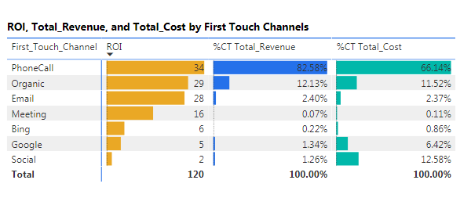
Conclusion
Total revenue: $831,066,000.00
Total cost: $29,351,730

Slide 7
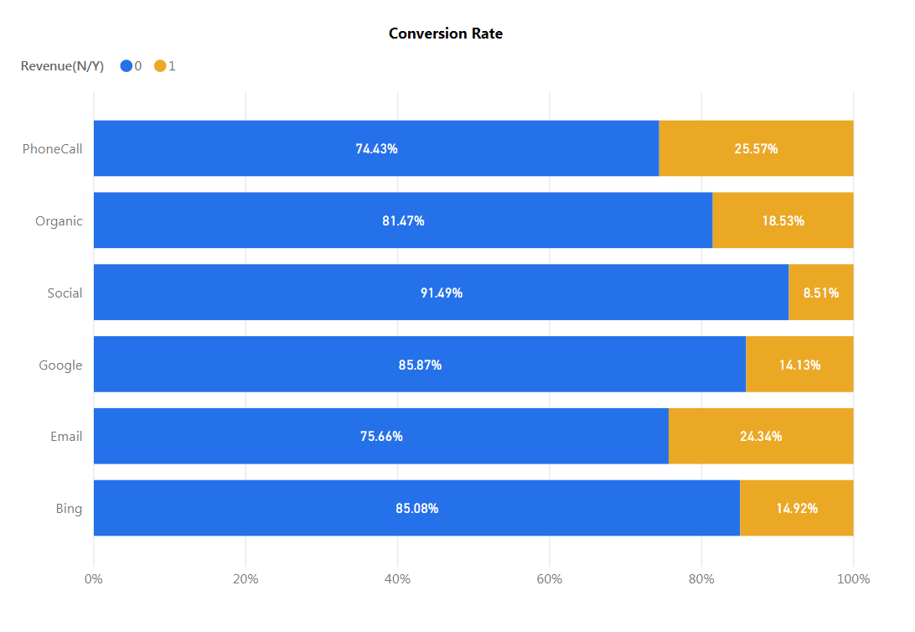
Conclusion

Slide 8
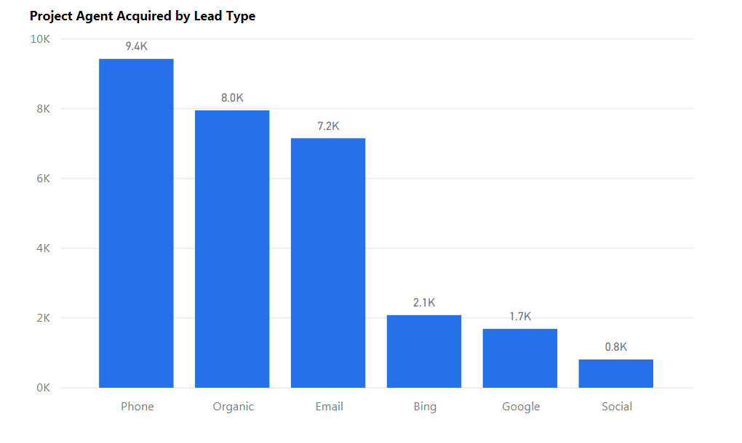
Conclusion
*Assuming 2M budget for each marketing channel

Slide 9
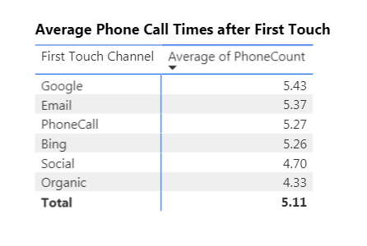
Recommendation
Increase budget on phone-call and email marketing
Cut down marketing expense on social media
Follow-up on leads generated from organic channels

Slide 10
Recommendation
Redistribution
Channels | Before | After
Phone Calls | 66.14% | 70%
Organic | 11.52% | 17%
Email | 2.37% | 6%
Meeting | 0.11% | 0.11%
Bing | 0.86% | 0.86%
Google | 6.42% | 3.5%
Social | 12.58% | 2.53%

Slide 11


Limitation
Data incompleteness
Data collection & correction
Time limitation
Position based model
Time series analysis

